Slide 1

SEARCHABLE SYMMETRIC ENCRYPTION
Group Members:
Muhammad Aftab Hameed 150904111
Saqib Hussain 150545295

Slide 2
INTRODUCTION
Searchable Symmetric Encryption (SSE) is a technique for storing the encrypted data in the database.
It allows the user to search over the encrypted database without the need of decrypting the data first.
It is used to protect sensitive information in scenarios where it is necessary to search over encrypted data such as cloud storage and database systems.
It allows users to store sensitive data on remote servers without compromising privacy.

Slide 3
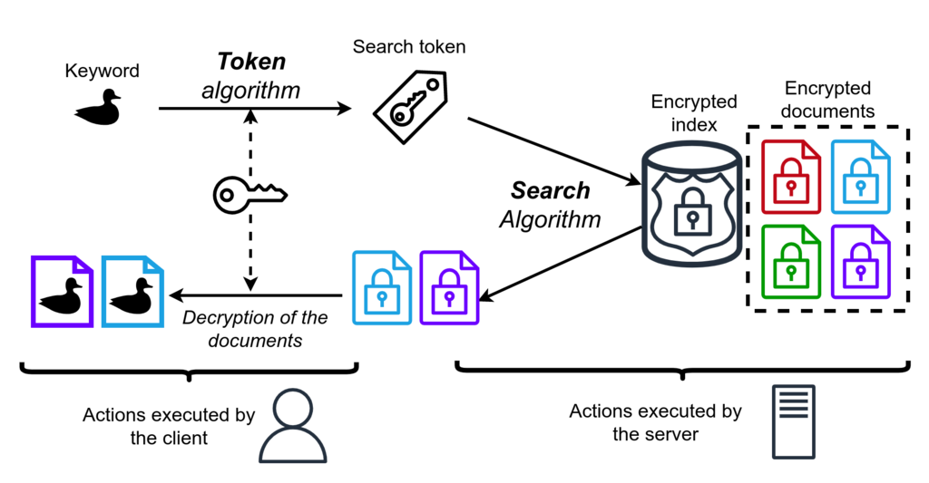
WORKING MECHANISM

Slide 4
STRUCTURE OF PROGRAM
The system can be divided into three main parts:
Frontend:
The frontend is developed using React
Backend:
The backend is developed using .Net Core(C#)
Database:
For the database, we have used SQL server and SQL database.

Slide 5
SECURE PROGRAMMING PRACTICES
In the implementation of this system, we have followed the best practices of secure programming which are mentioned below:
Exception Handling:
The code is written in the try-catch block so that we can catch exceptions instead of crashing down our system.
Error Handling:
We have handled system-defined(exceptions) and user-defined errors which give proper messages when an operation either fails or succeeds.

Slide 6
SECURE PROGRAMMING PRACTICES
File Validation:
We have applied the following file validations:
Ensure that the user uploads actual text files.
File extension must be .txt
File size must not be greater than 5MB.
The file must be safe(does not contain executable code or malicious script).
The file name must be unique.
Encrypted Database:
Our entire database is encrypted since it is an implementation of Searchable Symmetric Encryption (SSE).

Slide 7
SECURITY TESTING
Some of the security test cases are:
Test case description | Test steps | Expected results | Actual results | Pass/Fail
File Validation | Upload any file other than text file | System should reject the input and return the error that file type is not allowed | System rejected the input and returned the error that file type is not allowed | Pass
 | Upload file larger than 5MB | System should return an error “File cannot be larger than 5mb.” | System returned an error “File cannot be larger than 5mb.” | Pass
 | Upload any file other than .txt extension | System should return an error “Allowed file extension is only .txt” | System returned an error “Allowed file extension is only .txt” | Pass
 | Upload exe file by changing the extension to .txt | System should not upload this file and should return an error. | System didn’t upload that file and returned an error “File is not safe.” | Pass
 | Upload a file twice with the same name | System should reject the file and return error that file already exists. | System rejected the file and returned the error that file already exists. | Pass
Error handling | Try to click upload button without selecting a file | System should return an error “File is required”. | System returned an error “File is required”. | Pass

Slide 8
SECURITY VULNERABILITY
During the testing phase, we tried to violate all the validations of this system. However, fortunately, every validation is working fine. We couldn’t find any security issue or vulnerability in our system.

Slide 9
SUGGESTIONS FOR IMPROVEMENT
Following are some suggestions for the improvement of this system:
Search by filename should be case insensitive.
Remove the limitation that the user has to remember the exact filename.

Slide 10
SOME USAGES OF SSE SCHEME
Some of the usages of the SSE scheme are:
Cloud Storage:
SSE is often used to encrypt data stored in cloud storage services like Dropbox, Google Drive, and OneDrive. This allows users to securely store and search their data without revealing its contents to the cloud provider.
Healthcare:
SSE is used to protect patient privacy in healthcare systems. Medical records are encrypted using SSE, which allows healthcare professionals to search for and retrieve records without exposing sensitive patient data.

Slide 11
SOME USAGES OF SSE SCHEME
Some of the usages of the SSE scheme are:
Financial Services:
SSE is used in financial services to protect customer data. Bank account information and transaction histories can be encrypted using SSE, which allows financial professionals to search for and retrieve data while maintaining the confidentiality of the customer's financial information.
Messaging Applications:
SSE is used to protect the privacy of messaging applications. Chat histories can be encrypted using SSE, which allows users to search for and retrieve messages without exposing the contents of the messages to the messaging service.

Slide 12


Slide 13

ANY QUSTIONS

Slide 14


